Slide 1

EU-WIDE STRESS TESTING
Analysis of the results for 2018 and 2021

Slide 2




Team Presentation
Flavia Scarfò
Financial Risk
and
Data Analysis
Federico Travascio
Financial Risk
and
Data Analysis
Fabio Tripodi
Financial Risk
and
Data Analysis
Giovanni B. Tozzi
Financial Risk
and
Data Analysis

Slide 3

SECTION TOPICS
1
Introduction: main features of stress tests
Authorities in charge, scenarios and methodologies
EBA Stress Test 2018
2
Key aspects, impact on capital ratios, main drivers of the impact
EBA Stress Test 2020/2021
3
Key aspects, impact on capital ratios, main drivers of the impact
Case study: Special Focus on Covid-19
4
Analysis of the impact of the pandemic

Slide 4


Objective
Static Balance Sheets approach
To assess the bank's capital strength
Over the three-year simulation period, no change in the volume of assets
Main features
of
EBA stress tests:
Authorities
Bottom-up approach
They are usually carried out every two years through the cooperation of several institutions: EBA, ECB, ESRB, NCA
The analysis starts from more detailed levels until it reaches towards aggregated levels to get an overall view
Analysis
Preliminary results
Granular analysis (very detailed).
Balance sheet, profit and loss account, regulatory capital, RWA must be analyzed.
Feedback system resembles a traffic light: green=clear, yellow=required further clarification, red=returned to sender for further processing.
The EU-wide stress test provides a shared analytical substrate, allowing supervisors, banking institutions and other market participants to uniformly outline and assess the robustness of EU banks in the face of adverse market developments and shocks

Slide 5



EBA Stress Test 2018
Banks participating: a sample of 48 banks in 15 countries in the European Union (EU) and European Economic Area (EEA) at the highest level of consolidation.
The main methodological change is the new expected credit losses (ECL) impairment model, which moves away from the previously ‘incurred loss’ model in IAS 39.
The main feature of the 2018 exercise is the implementation of IFRS 9, which replaces IAS 39
IFRS 9, which replaces IAS 39
Public guarantee schemes
FX variations

Slide 6
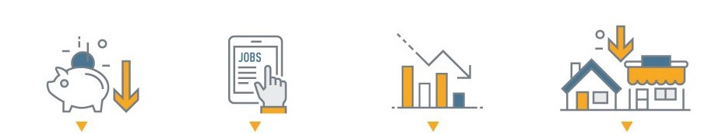
Adverse Scenario 2018
The most important shocks of the EU adverse scenario would lead to:
Cumulative fall in GDP over 3 years by 2.7%
Unemployment reaches in 2020 9.7%
Cumulative inflation over 3 years stands at 1.7%
Cumulative fall in residential and commercial real estate prices over 3 years of 19.1% and 20% respectively

Slide 7
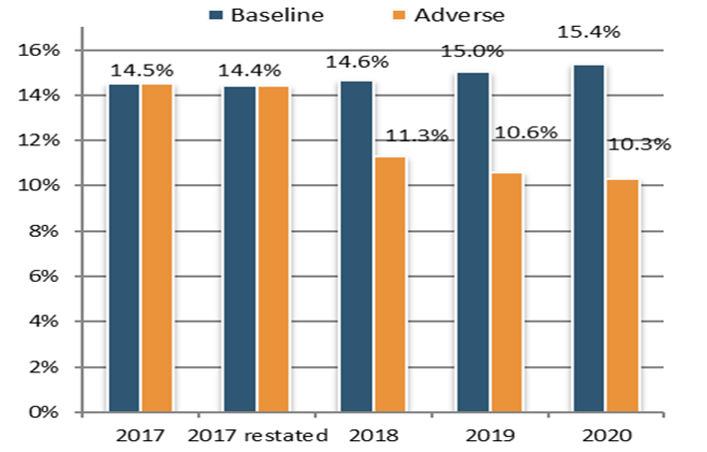
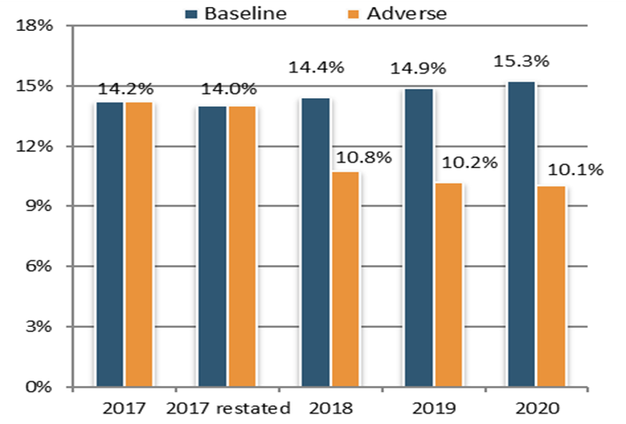
Impact on Transitional CET1
Impact on Fully-Loaded CET1
(starting point 14.5%)
(starting point 14.2%)
IFRS 9 first implementation: -10bps
Stress test impact: -410bps
Capital depletion: €236bn
Increase of total REA: €1055bn
IFRS 9 first implementation: -20bps
Stress test impact: -395bps
Capital depletion: €226bn
Increase of total REA: €1049bn
Notes:
If you want to change the picture background.
1) Select the shape (in front of the image) and send it to back
2) Delete the image and drag and drop you own // 3) Send to back the new image

Slide 8
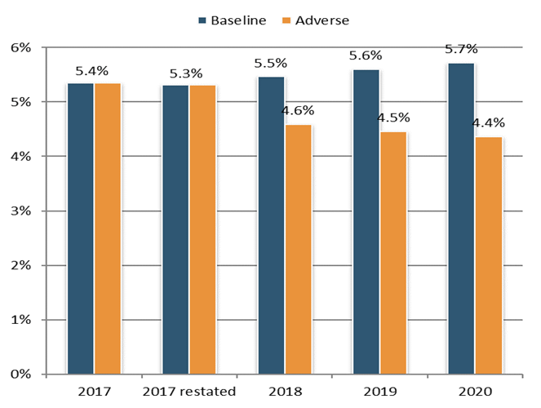
Drop solely due to decreasing T1 capital, as leverage exposure remain constant.
In 2018, adverse scenario, two banks report a ratio below the 3% LR.
In 2019, adverse scenario, three banks fall below the 3% LR.
In 2020, adverse scenario, three banks fall below the 3% LR.
Impact on Aggregate
Leverage Ratio
Transitional leverage ratio falls from 5.4% in 2017 to 4.4% in 2020
Fully loaded leverage ratio falls from 5.1% in 2017 to 4.2% in 2020
The chart shows the evolution of transitional aggregate leverage ratio

Slide 9



Main drivers of the impact (1/2)
TOTAL REA
increases by 12% as of end 2020 compared to the starting point, driving an impact on CET1 capital ratio of
-160bps
CREDIT
RISK
has the highest impact, it detracts 425 bps from the CET1
capital ratio as of end-2020
MARKET
RISK
has an impact on CET1 capital ratio of
–110 bps
OPERAT.
RISK
drives banks’ CET1 capital ratio further down by 100bps.
*Other drivers to the impact on banks’ capital are related to non-interest income and expenses items (NFCI, dividend income).

Slide 10
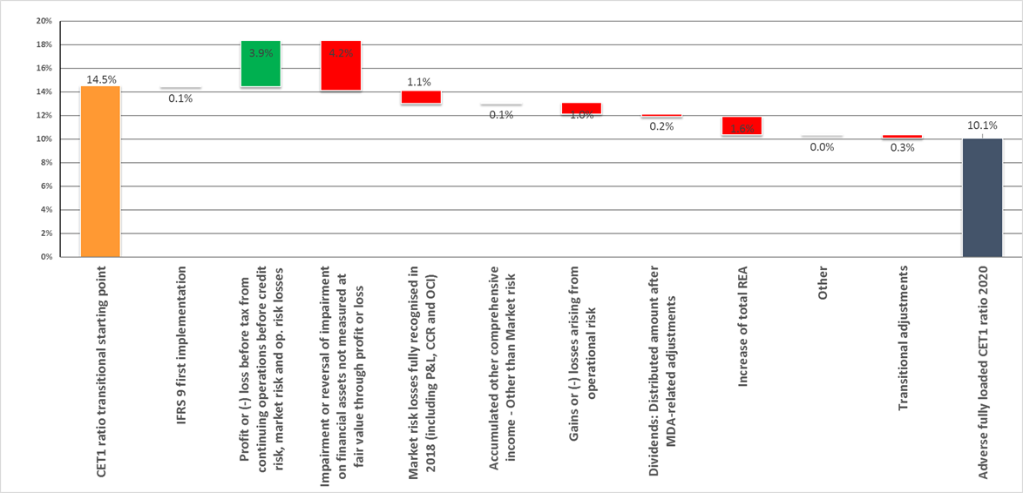
Main drivers of the impact (2/2)

Slide 11

EBA Stress Test 2020-2021
METHODOLOGY
The stress has been postponed to 2021 by the EBA due to the global spread of COVID-19.
Banks participating: a sample of 50 banks, covering 70% of total banking assets across 15 countries of EU and EEA.
Main methodological changes compared to the 2018 exercise: the treatment of sight deposits, changes in the minimum NPL coverage, a new securitization framework, P2R disclosure, and enhancing transparency in the credit risk area.
EBA-compliant moratoria
Public guarantee schemes
Amendments
FX variations

Slide 12
Adverse Scenario
2020/2021
The most important shocks of the EU adverse scenario would lead to:
Cumulative fall in GDP over 3 years by 3.6%
Unemployment rate would rise by 4.7%
Cumulative inflation over 3 years stands at 1.7%
Cumulative fall in residential and commercial real estate prices over 3 years of 16.1% and 31.2% respectively

Slide 13
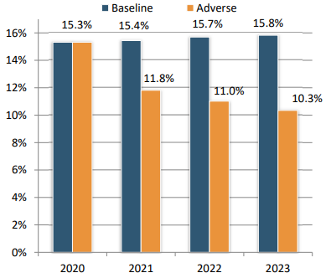
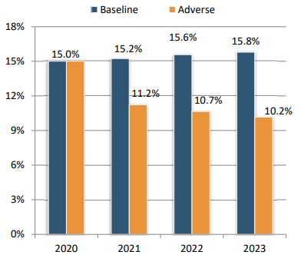
Impact on Transitional CET1
Impact on Fully-Loaded CET1
(starting point 15.3%)
(starting point 15%)
Stress test impact: -497 bps
Capital depletion: €273bn
Increase of total REA: €866bn
Stress test impact: -485 bps
Capital depletion: €265bn
Increase of total REA: €868bn
Notes:
If you want to change the picture background.
1) Select the shape (in front of the image) and send it to back
2) Delete the image and drag and drop you own // 3) Send to back the new image

Slide 14
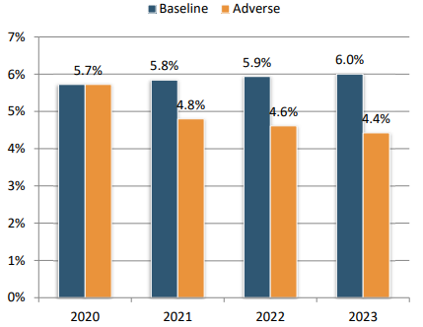
The drop is solely due to decreasing T1 capital, as leverage exposure remains constant.
In the adverse scenario, four banks report a ratio below 3% for every year of the stress
Impact on Aggregate
Leverage Ratio
Transitional leverage ratio falls from 5.7% in 2020 to 4.4% (-130 bps)
Fully loaded leverage ratio falls from 5.6% to 4.3% (-124 bps)
The chart shows the evolution of transitional aggregate leverage ratio

Slide 15
Main drivers of the impact (1/2)
TOTAL REA
increases by about 12% as of end 2023, driving an impact on CET1 capital ratio of -121 bps.
CREDIT
RISK
has the highest impact: ‐€308bn, ‐423bps
MARKET
RISK
including OCI ‐€74bn, ‐102bps.
OPERAT.
RISK
‐€49bn,
‐68bps, mostly conduct risk, ‐37bps..
*Other drivers to the impact on banks’ capital are related to non-interest income and expenses items (NFCI, dividend income).

Slide 16
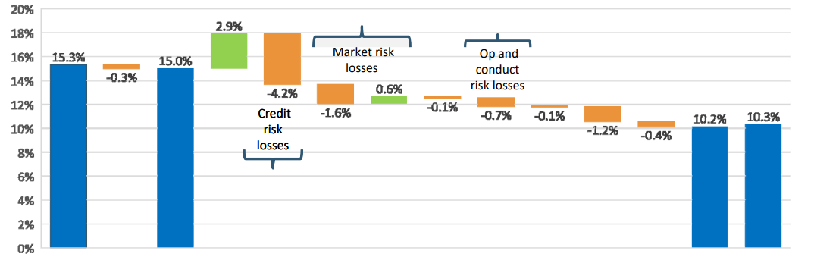
Main drivers of the impact (2/2)
CET 1 starting point
(Transitional and Fully-Loaded)
CET1 considering the adverse scenario
(Transitional and Fully-Loaded)

Slide 17
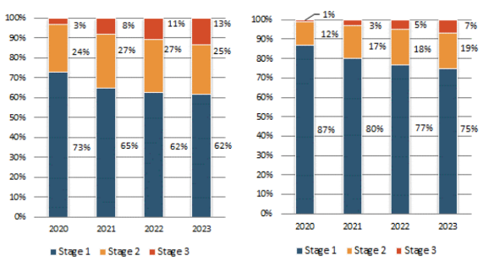
The percentage of bank exposures in the sample that were subject to moratoria at the end of 2020 was 4.2%; 1.4% of these exposures had not expired.
As PGS were primarily provided for recently originated loans, the overall percentage of exposures under the PGS is substantially lower (1.6% of total exposures).
Special Focus on Covid-19
Over the stress test horizon, exposures under moratoria classified in stage 3 increased from 3.1% at the end of 2020 to 13.4% in 2023.
For exposures under PGS, the stage 3 ratio increased from 1.1% in 2020 to 6.8% in 2023
Composition of exposures under moratoria (1) and under PGS (2)

